Slide 1
Computer Network and Communication
CNS3200

Slide 2
Learning Outcome
EXPLAIN THE MECHANISM & SHOW THE CALCULATION OF ERROR CONTROL AND THE RELATED PROTOCOLS (NS)

Slide 3
Contents
Data Link Layer
Types of Error
  Single bit error
  Burst error
Error Detection
  Parity Check
  CRC
  Checksum
Error Correction
  Hamming Code

Slide 4
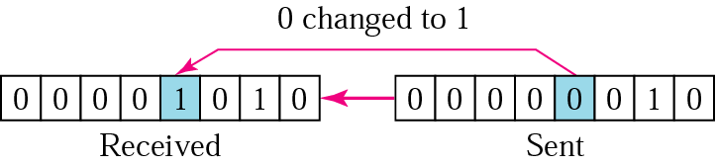
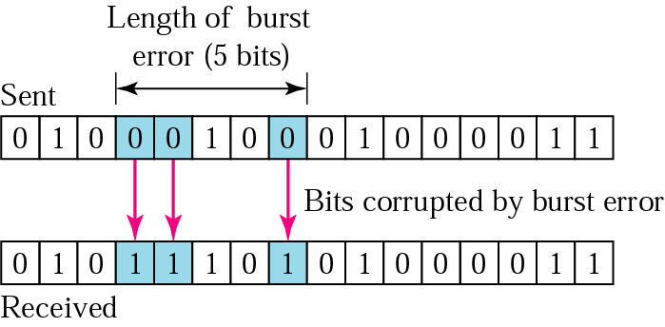
Types of Errors
Single bit error – only one bit is changed from 1 to 0 or from 0 to 1.
Burst error – two or more bits in the data unit have changed.

Slide 5
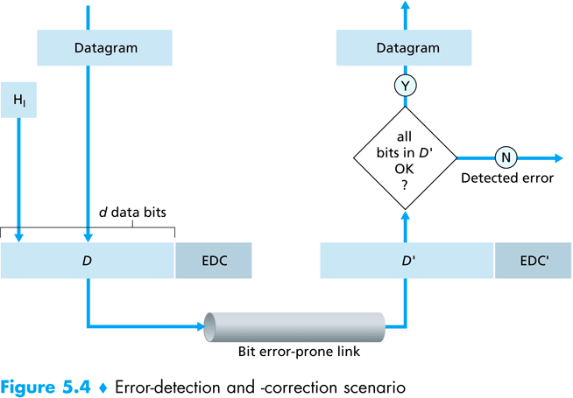
Error Detection
Error detection uses the concepts of redundancy, which means adding extra bits detecting errors at the destination.

Slide 6
3 common error detection techniques
Parity Check
Checksum
(most basic)
(used primarily by upper layers)
Cyclic Redundancy Check (CRC)
(normally implemented in link layer)

Slide 7
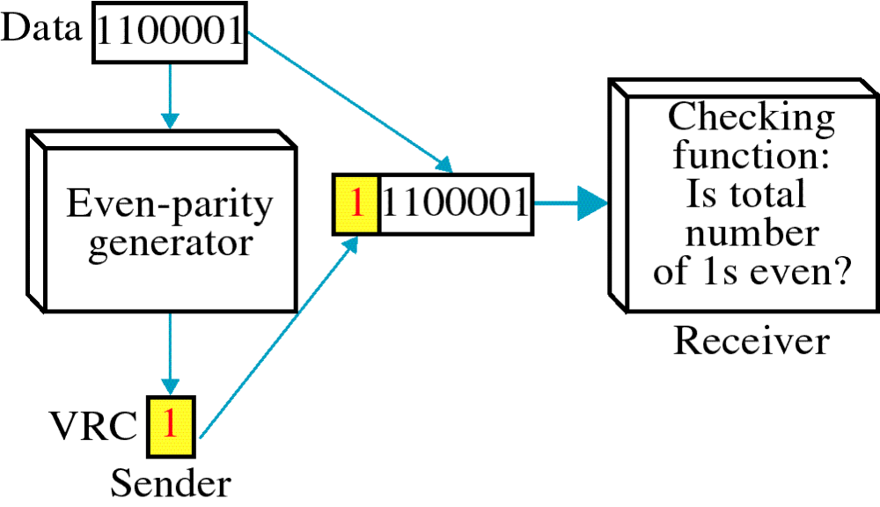
Parity Check
Simplest technique.
A redundant bit (parity bit), is appended to every data unit.
Even parity - the total number of 1's in the data plus parity bit must be an even number.

Slide 8
Even Parity Generator
Data #1's in data P Total # 1's (data and P)
0110110 4 (Even) 0 4 (Even)
0011111 5 (Odd) 1 6 (Even)
0000000 0 (Even) 0 0 (Even)
1010100 3 (Odd) 1 4 (Even)
1111111 7 (Odd) 1 8 (Even)

Slide 9
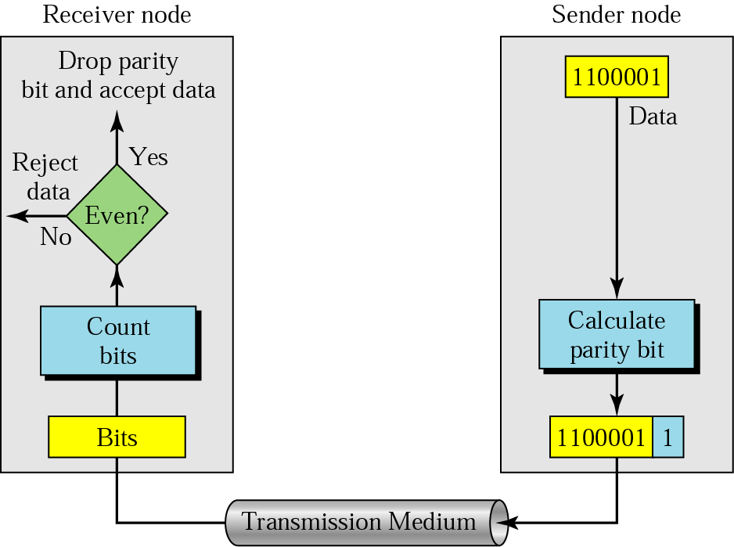

Slide 10
Example 1
Even Parity
Suppose the sender wants to send the word world. In ASCII the five characters are coded as
1110111 1101111 1110010 1101100 1100100
The following shows the actual bits sent
11101110 11011110 11100100 11011000 11001001

Slide 11
Example 2
Even Parity
Now suppose the word world in Example 1 is received by the receiver without being corrupted in transmission.
11101110 11011110 11100100 11011000 11001001
The receiver counts the 1s in each character and comes up with even numbers (6, 6, 4, 4, 4). The data are accepted.

Slide 12
Example 3
Even Parity
Now suppose the word world in Example 1 is corrupted during transmission.
11111110 11011110 11101100 11011000 11001001
The receiver counts the 1s in each character and comes up with even and odd numbers (7, 6, 5, 4, 4). The receiver knows that the data are corrupted, discards them, and asks for retransmission.

Slide 13
CRC
XOR Truth Table
The most powerful of the redundancy checking technique.
Based on binary division.
The redundancy bits used by CRC are derived by dividing the data unit by a predetermined divisor; the remainder is the CRC.
A CRC must:
  have exactly one less bit than the divisor
  appending it to the end of the data string must make the resulting bit sequence exactly divisible by the divisor.

Slide 14
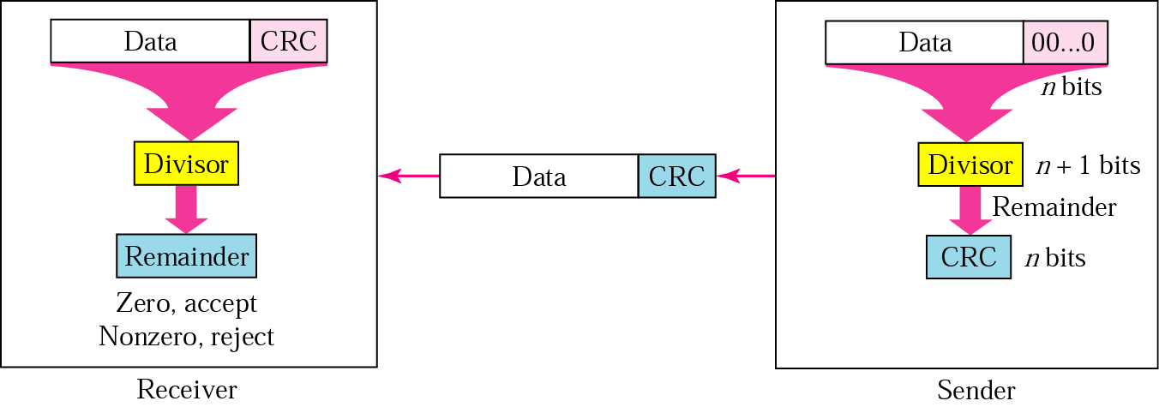
CRC generator and checker
Receive the frame.
Divide it by divisor.
Check the reminder.
Get the raw frame.
Left shift the raw frame by n bits and divide it by divisor.
The remainder is the CRC bit.
Append the CRC bit to the frame and transmit.

Slide 15
XOR Operation (Exculsive OR)
Input |  | Output
A | B
0 | 0 | 0
0 | 1 | 1
1 | 0 | 1
1 | 1 | 0

Slide 16

Division in CRC encoder

Slide 17

Division in the CRC decoder for two cases

Slide 18
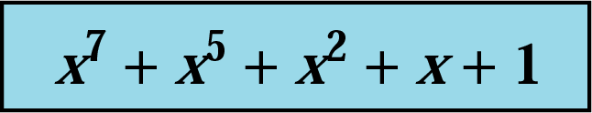
CRC
CRC generator – at the sending node.
CRC checker – at the receiving node.
Polynomial:
  The CRC generator (the divisor) is most often represented as an algebraic polynomial.
  e.g.

Slide 19
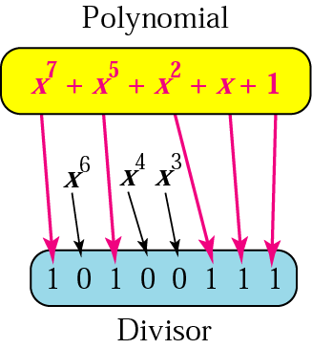
A polynomial representing a divisor

Slide 20
Standard polynomials
Name | Polynomial | Application
CRC-8 | x⁸ + x² + x + 1 | ATM header
CRC-10 | x¹⁰ + x⁹ + x⁵ + x⁴ + x ² + 1 | ATM AAL
ITU-16 | x¹⁶ + x¹² + x⁵ + 1 | HDLC
ITU-32 | x³² + x²⁶ + x²³ + x²² + x¹⁶ + x¹² + x¹¹ + x¹⁰ + x⁸ + x⁷ + x⁵ + x⁴ + x² + x + 1 | LANs

Slide 21

Checksum
The error detection used by the higher-layer protocols.
Check generator – in the sending node
Checksum checker – at receiving node
Ethernet frame

Slide 22
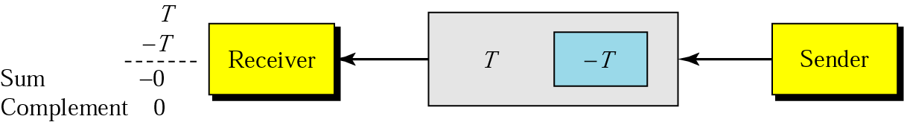
Data unit and checksum

Slide 23
Example 6
Suppose the following block of 16 bits is to be sent using a checksum of 8 bits.
10101001 00111001
The numbers are added using one’s complement
10101001
00111001
------------
Sum 11100010
Checksum 00011101
The pattern sent is 10101001 00111001 00011101

Slide 24
Example 7
Now suppose the receiver receives the pattern sent in Example 6 and there is no error.
10101001 00111001 00011101
When the receiver adds the three sections, it will get all 1s, which, after complementing, is all 0s and shows that there is no error.
10101001
00111001
00011101
------------
Sum 11111111
Complement 00000000 means that the pattern is OK.

Slide 25
Example 8
Now suppose there is a burst error of length 5 that affects 4 bits.
Original data 10101001 00111001 00011101
Corrupted data 10101111 11111001 00011101
When the receiver adds the three sections, it gets
10101111
11111001
00011101
Partial Sum 1 11000101
Carry 1
Sum 11000110
Complement 00111001 the pattern is corrupted.

Slide 26
Error Correction
Hamming Code
Focus on a simple case: Single-Bit Error Correction
Use the relationship between data and redundancy bits
Developed by Richard Hamming

Slide 27
Data and redundancy bits
Number of data bits m | Number of redundancy bits r | Total bits m + r
1 | 2 | 3
2 | 3 | 5
3 | 3 | 6
4 | 3 | 7
5 | 4 | 9
6 | 4 | 10
7 | 4 | 11

Slide 28
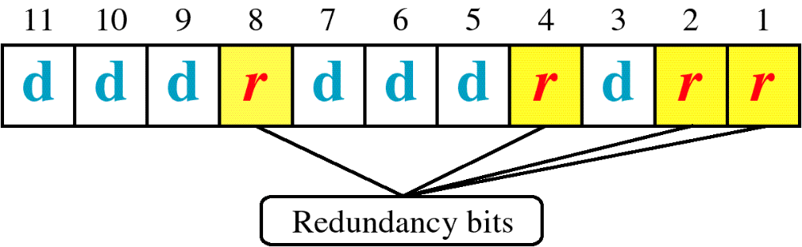
Positions of redundancy bits in Hamming code (11,7)
* Check bits occupy positions that are powers of 2

Slide 29
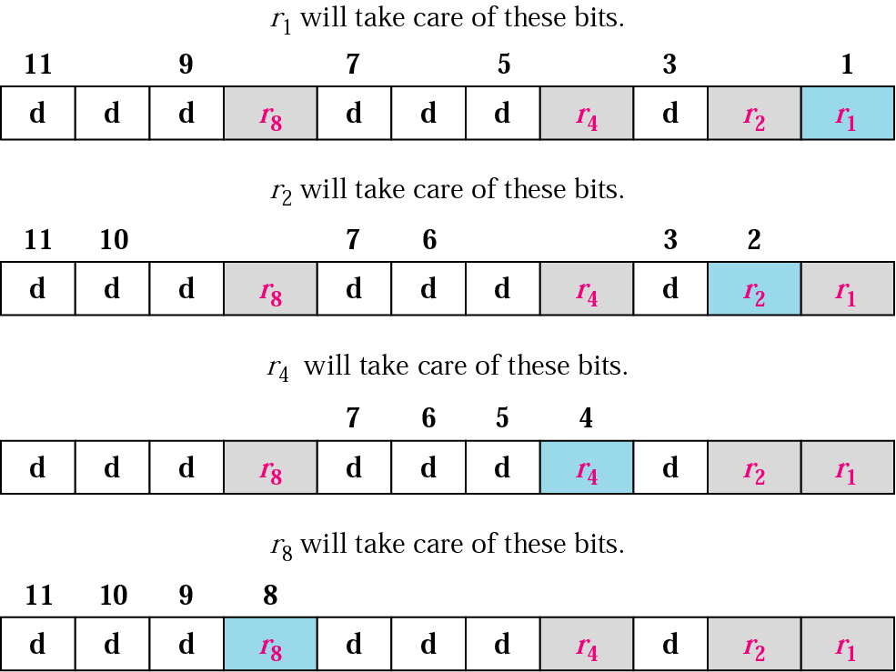
All bit positions that are powers of 2 are used as parity bits. (positions 1, 2, 4, 8…)
All other bit positions are for the data to be encoded. (positions 3, 5, 6, 7, 9, 10, 11…)
Each parity bit calculates the parity for some of the bits in the code word. The position of the parity bit determines the sequence of bits that it alternately checks and skips.
General rule for position n: skip n−1 bits, check n bits, skip n bits, check n bits...
Position 1 (n=1): skip 0 bit (0=n−1), check 1 bit (n), skip 1 bit (n), check 1 bit (n), skip 1 bit (n), etc. (1,3,5,7,9,11...)
Position 2 (n=2): skip 1 bit (1=n−1), check 2 bits (n), skip 2 bits (n), check 2 bits (n), skip 2 bits (n), etc. (2,3,6,7,10,11...)
Position 4 (n=4): skip 3 bits (3=n−1), check 4 bits (n), skip 4 bits (n), check 4 bits (n), skip 4 bits (n), etc. (4,5,6,7,12...)
Position 8 (n=8): skip 7 bits (7=n−1), check 8 bits (n), skip 8 bits (n), check 8 bits (n), skip 8 bits (n), etc. (8-15,24-31,40-47,...)

Slide 30
Redundancy bits calculation

Slide 31
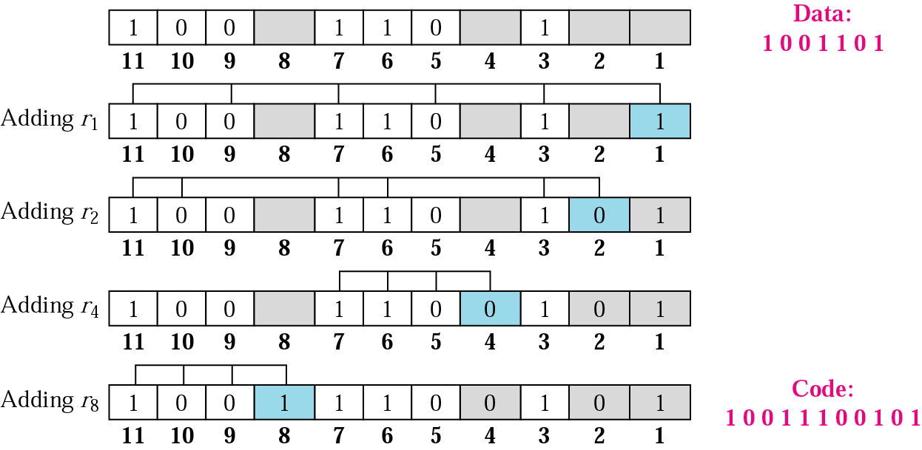
Example of redundancy bit calculation

Slide 32
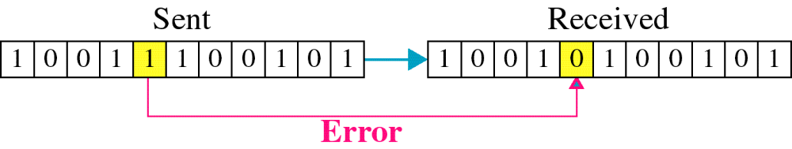
Single-Bit Error

Slide 33

Error detection using Hamming code
Error
Detection

